Slide 1

Certificate of Deposit Survey & Competitors Report
Stephanie Chew
Marketing Data Analyst

Slide 2


Objective
Analyze 2020 certificate of deposit terms and which is the most popular certificate of deposit term to create the marketing campaign.
Check our competition with other banks in New York.
Goal: To generate assets for the bank by the end of the year.

Slide 3
Federal Deposit Insurance Corporation and CD
Federal Deposit Insurance Corporation (FDIC): U.S. government agency created by the U.S. Congress.
Certificate of Deposit (CD): Special type of savings account.
The certificate of deposit account is a current asset account representing the investment by the business.

Slide 4
About The Data
Obtained from Federal Deposit Insurance Corporation (FDIC) website. Quarterly reports, dated by end of each quarter. Q1 = 3/31; Q2 = 6/30; Q3 = 9/30; Q4 = 12/31.
Community Banks: Commercial banks that derives funds from and lends to the community where it operates and is not affiliated with a multibank holding company.

Slide 5
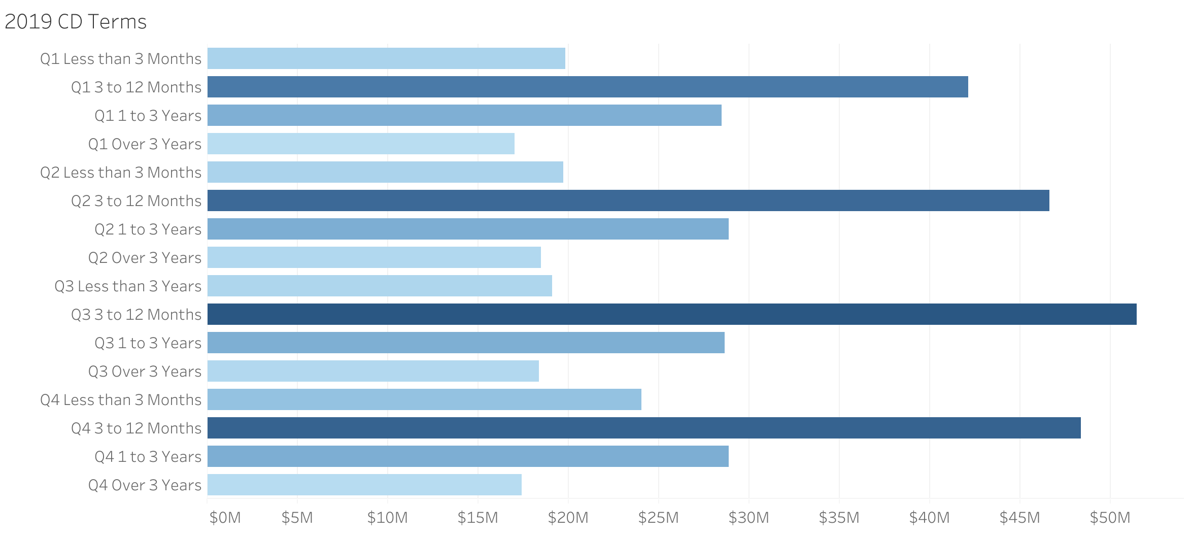
2019 CD Terms
3 to 12 months term has highest total amount, compare to other terms.
Highest total CD deposits is over $50M.

Slide 6
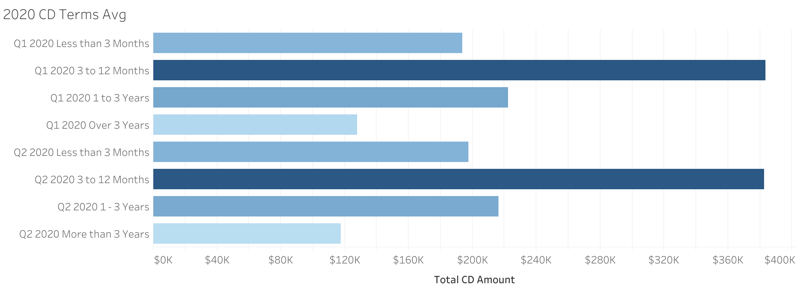
2020 CD Terms by Average
Average amount is steady for the first two quarters of 2020.
3 to 12 months CD term is still a popular product.

Slide 7
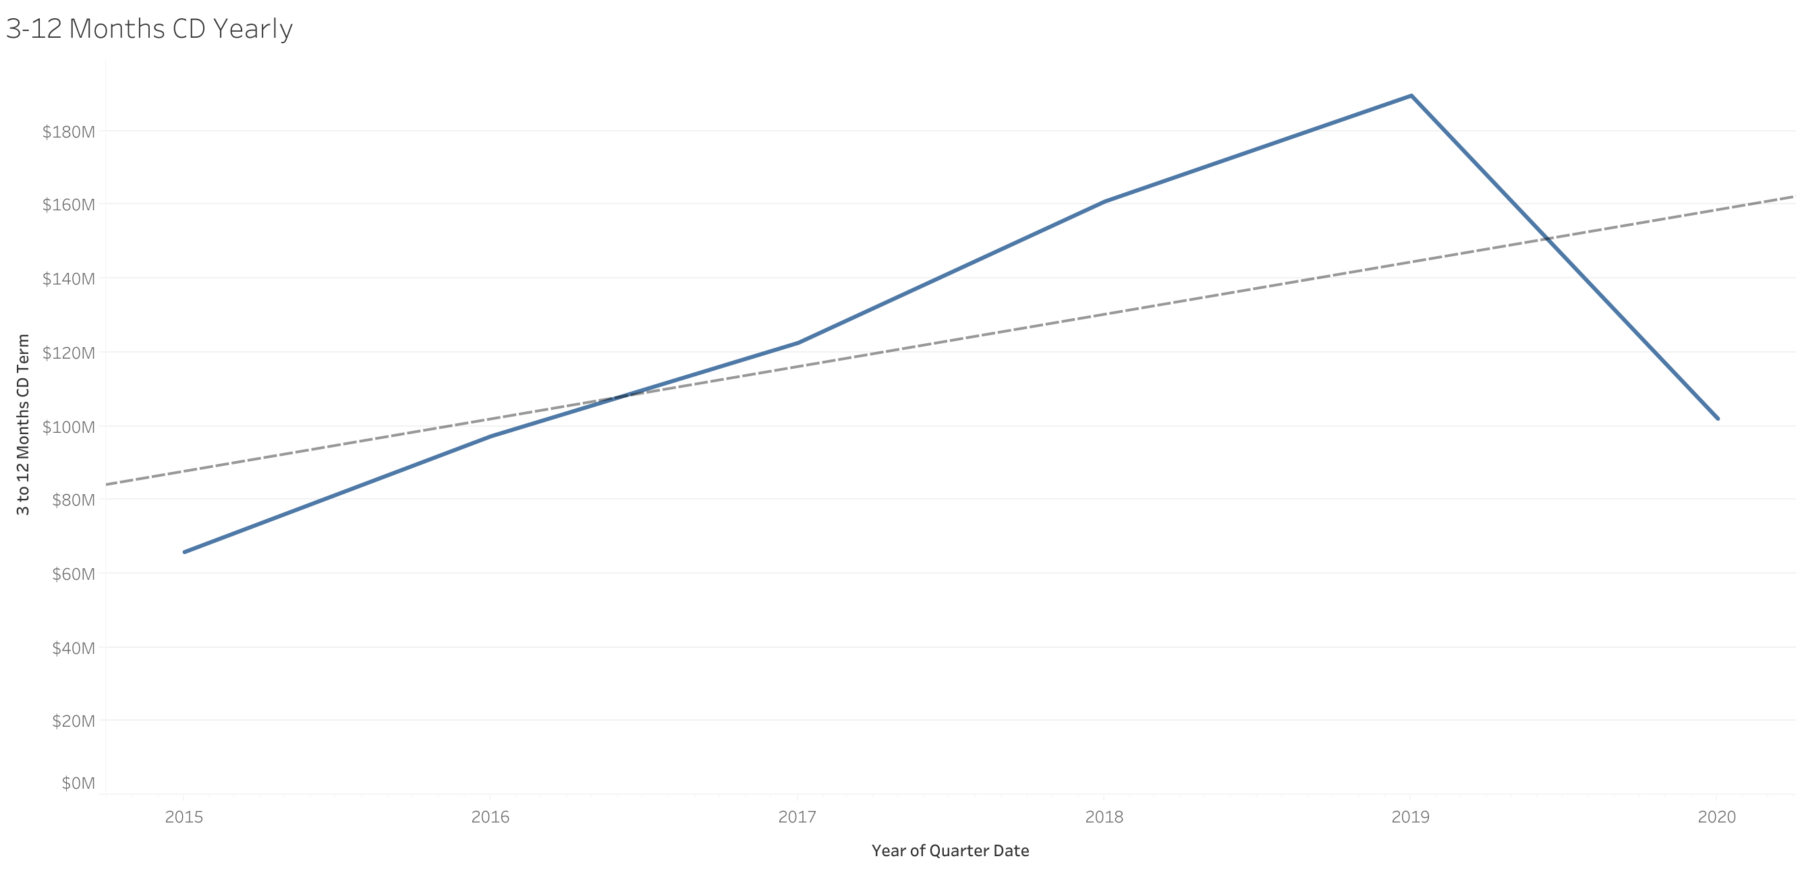
3 to 12 months CD terms Over Time
Used Linear Regression Model.
There is little correlation between 3 to 12 months CD terms and yearly dates.
Will need more historical data to further investigate.

Slide 8
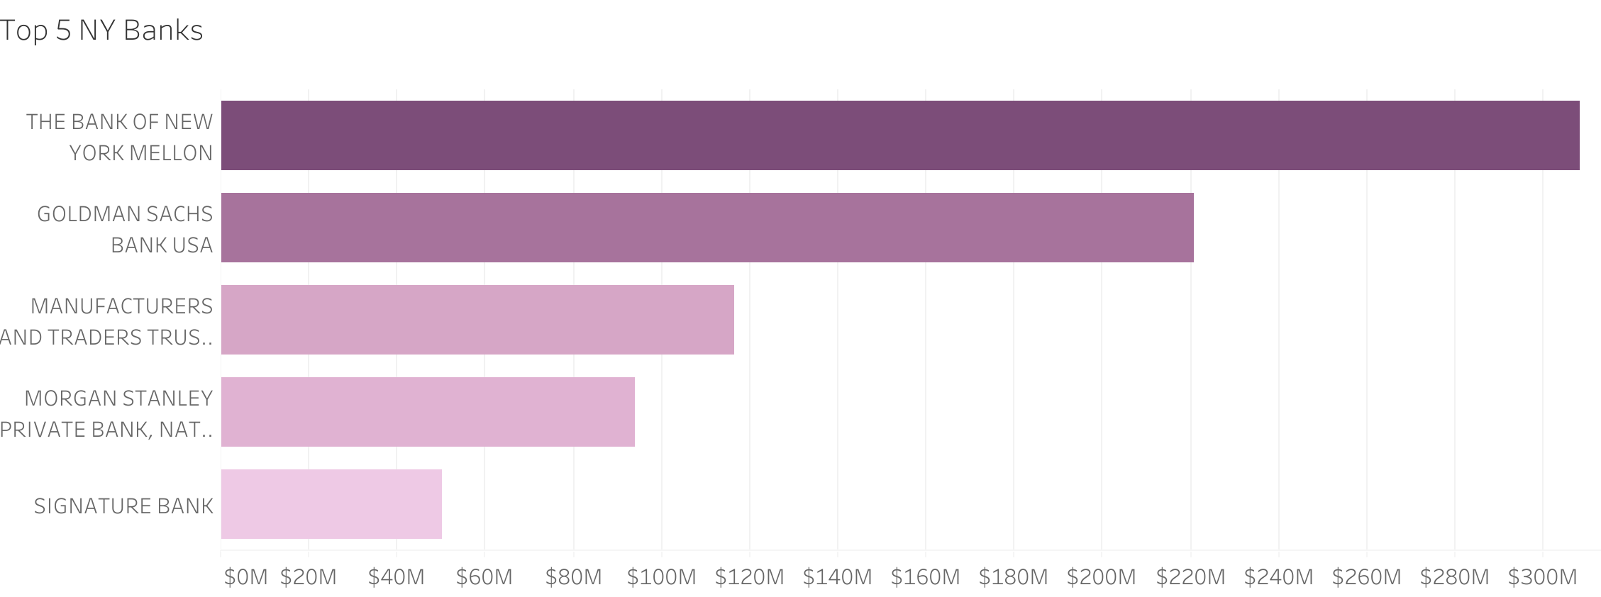
Top 5 Large NY Banks as of 6/30/2020
Based on the total deposits.
#1 bank with highest total deposits is Bank of New York Mellon.
BNY Mellon is an investment bank and operates in 35 countries. Primarily offers commercial banking products, investment services and investment management.

Slide 9
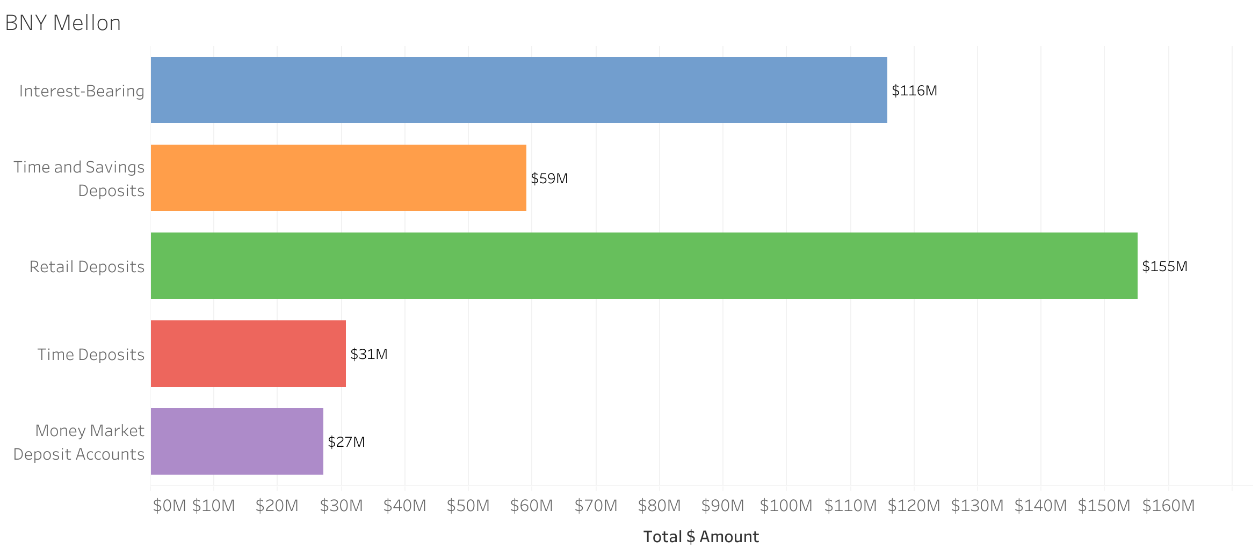
BNY Mellon
As of 6/30/2020.
Highest total amount is retail deposits with $155M. That includes personal checking, personal savings, and certificate of deposit.
Interest-bearing accounts at $116M, which includes interest checking accounts.

Slide 10
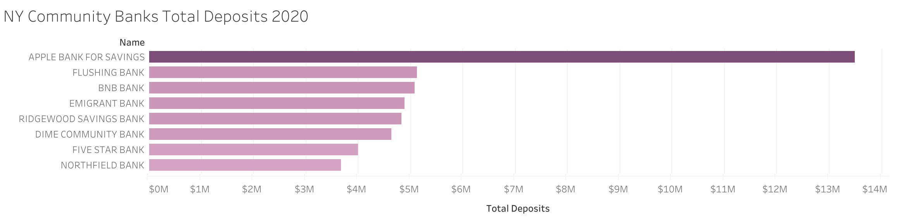
NY Community Banks as of 06/30/2020
Apple Bank for Savings is the #1 community bank who makes the most total deposits.
One of the oldest community banks in New York with 80 branches.

Slide 11

Apple Bank’s CD Promotion
Currently running a 1-year CD term promotion.
0.90% APY, $1000 minimum.

Slide 12

Conclusion and Next Steps
Can conclude that 3 – 12 months CD terms is a very popular product. Apple Bank’s marketing campaign for CD 1-year term supports that.
Check account opening requirements by following legal guidelines.
Market research individual competitor banks' rates and terms.
Work with the marketing and product team.
Meet with compliance team to review disclosures.

Slide 13
Contact Info
Email: stephanie.a.chew@gmail.com
Github: github.com/StephanieChew-nyc
Linkedin: linkedin.com/in/chewstephanie/

Slide 14
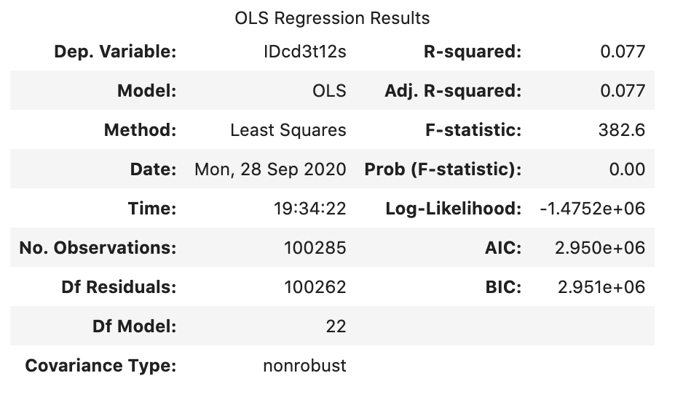
Appendix
Linear regression model. Compares 3 to 12 months CD and quarter dates.

